Slide 1
DO NOT SHOW
Microsoft Cloud Adoption Framework for Azure – Unlock cloud adoption with Azure landing zones
Speaker:
CSA, Specialist, ATS, AE
Speaker:
Primary Audience:
ITDM, BDM, Cloud Architect
Audience:
Impacted Audience:
Level:
Foundational (100)
Usage guide:
Usage guide:
This presentation is designed to provide an overview of how to unlock cloud adoption with Azure landing zones the Cloud Adoption Framework for Azure. Please tailor to fit your customers' needs.
Additional supporting materials:
Documentation https://aka.ms/adopt/overview
Microsoft Assessments https://aka.ms/adopt/assess
Partner offers: https://aka.ms/adopt/partneroffers
Consulting services Microsoft Consulting Services
Learning module Cloud Adoption Framework Learn module
Key contact for support:
Evelyn Padrino, Sonia Yu
Notes:
Suggested approach –
Use Slides 2-16 for introduction and high-level overview
OPTIONAL: Choose slides between 17 through 20 depending on your customers need and whether you need information for partners.
End with Slides 21-23 that has Resources that can help.

Slide 2
Unlock cloud adoption with Azure landing zones
[Name]
[Title, Team]

Slide 3
Agenda
1
2
3
4
The right foundation
Azure Landing Zones
Partner opportunities
Resources
Notes:
Use #3 (slides between 17 through 20) depending on your customers need and whether you need information for partners.

Slide 4
The right foundation
Notes:
[Title slide]
<Key point>: What does building with the right foundation mean?
Cloud adoption is like building a house.
You must build a solid foundation first.
<Transition>: Choosing the “right foundation” depends on what you’re building.

Slide 5

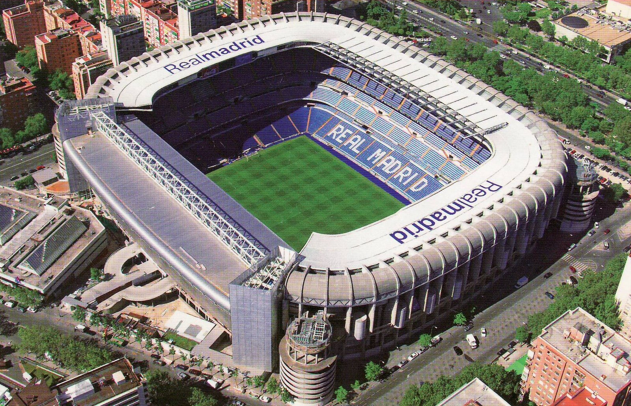

What are you going to build?
A house
A stadium
A bridge
Notes:
<Key point>: Deciding what you’re going to build will drive what foundation to choose.
Each of these buildings requires a different foundation.
<Transition>: What foundation is the right one?

Slide 6
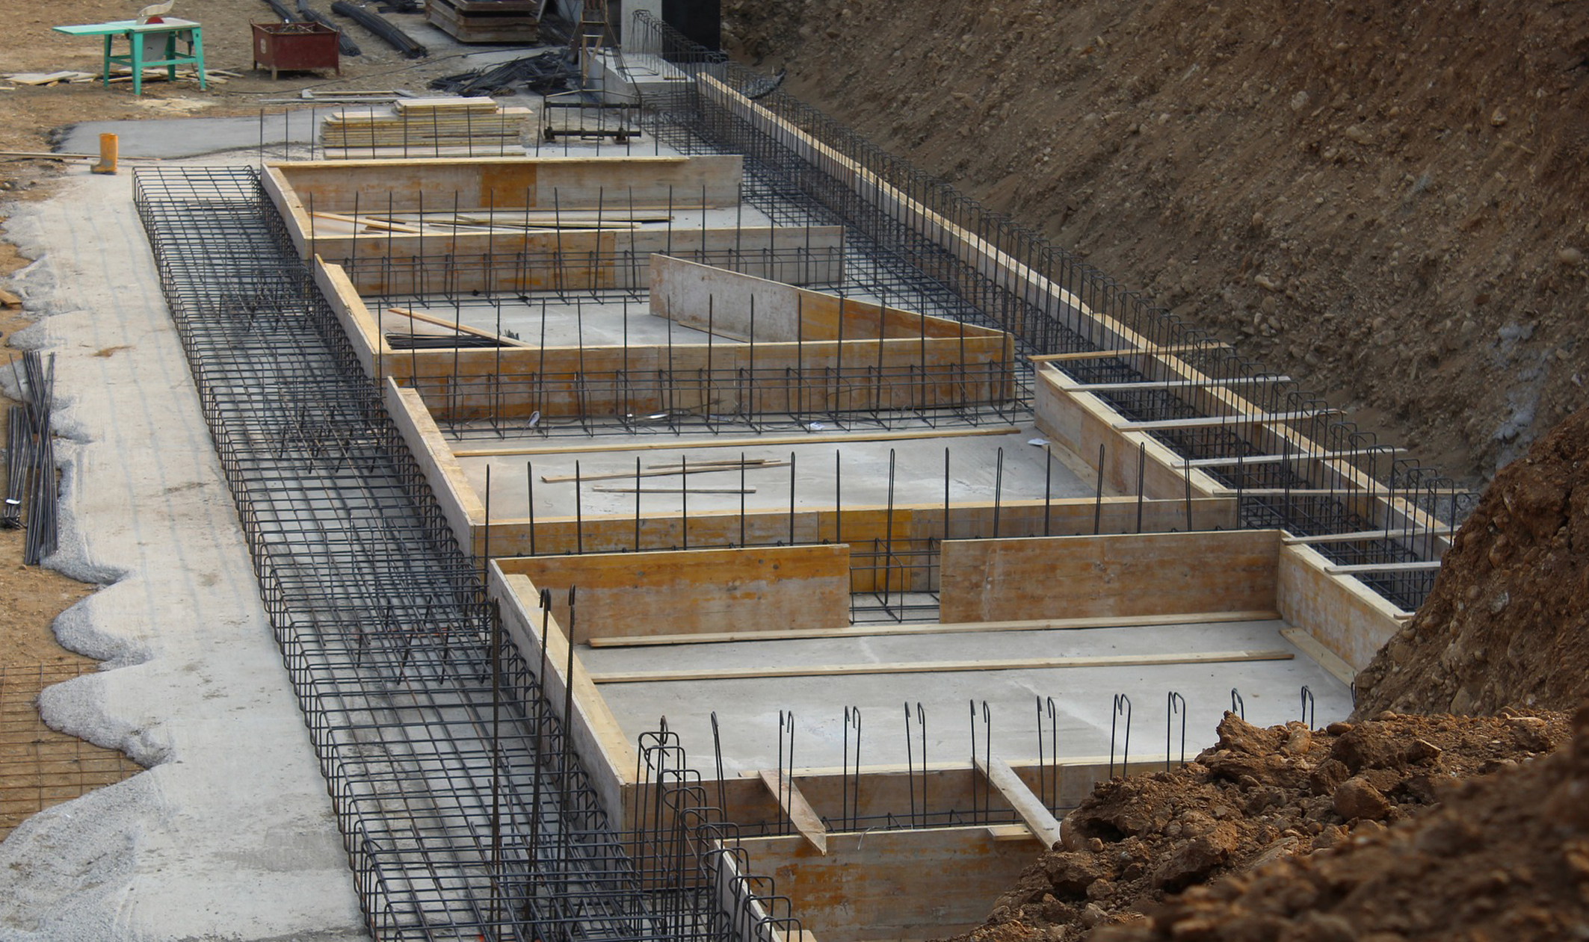
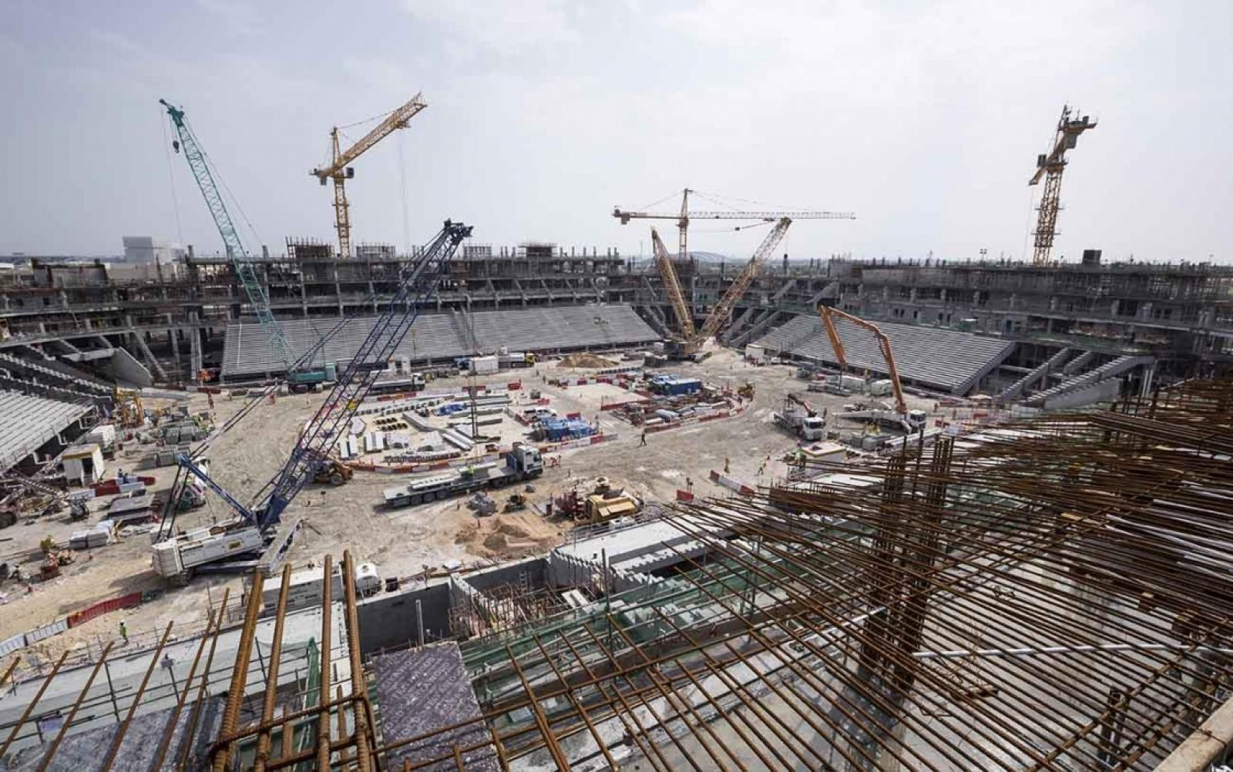
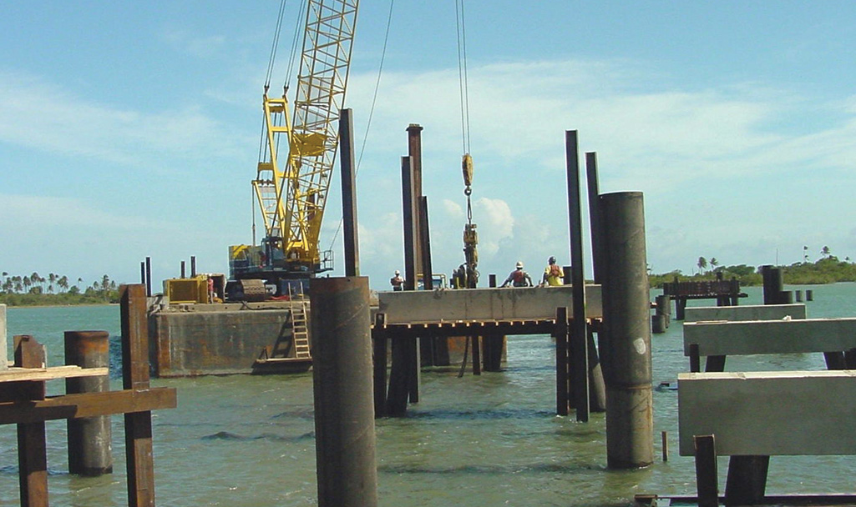
All foundations are NOT created equal
A house
A stadium
A bridge
Notes:
<Key point>: The foundation selection depends on what you’re building.
Foundations will be tailored to the construction of what’s being built above it.
<Transition>: Choosing the right structural foundation is like choosing the right cloud foundation.

Slide 7





The value of creating cloud-ready environments
Aligned to business priorities
Cloud-design considerations
Adapted for cloud operating model
Ready for cloud applications
Adaptable to grow and expand
Compliant
Agile
Cutting-edge innovation
Secure
Notes:
<Key point>: Constructing a cloud-ready environment is like building a house structurally up to code.
If a customer wants to build an app in the cloud, we must build the environment that helps them deliver on their business priorities.
What is the cloud operating model that is running the application?
We must ensure that the environment scales as the application becomes more robust and more complex.
And of course, the cloud environment must be compliant.
Cloud-ready environments help customers to become agile, make use of innovative technologies, and remain secure.
<Transition>: Let’s look at how Azure landing zones help customers.

Slide 8
Azure landing zones
Notes:
[Title slide]

Slide 9
Azure landing zones
Azure landing zones help customers set up their Azure environment for scale, security, governance, networking, and identity.
Azure landing zones:
Enable migrations and net new apps
Consider all platform resources
Don't differentiate between IaaS or PaaS
Notes:
<Key point>: What are Azure landing zones and how do they help customers?
[Review main points]
key messaging:
“Azure landing zones support all paths to the cloud, (including migrations on-prem to the cloud) and building net new applications.”
<Transition>: Let’s look at how Azure landing zones fit in with the Microsoft Cloud Adoption Framework.

Slide 10
Microsoft Cloud Adoption Framework for Azure
Proven business and technical guidance to help customers create and implement the business and technology strategies necessary to succeed in the cloud
Define strategy
Define business justification and expected outcomes
Plan
Align actionable cloud adoption plan to business outcomes
Ready
Prepare people, process and environment for change
Adopt
Migrate or Innovate
Implement desired changes across IT and business processes
Govern
Comply, control and secure
Manage
Operate and optimize
Notes:
<Key point>: The Ready stage of the Microsoft Cloud Adoption Framework involves preparing organizations’ people, process and environment for digital transformation.
We want to enable customers to successfully adopt the Azure cloud.
When we’re talking about cloud adoption and landing zones, we’re pointing to the Ready stage.
In the Ready stage, cloud adoption plans have been discussed and defined, and we are ready to deploy a workload on Azure.
<Transition>: Let’s look at Azure landing zones in much more detail.

Slide 11

Azure Landing Zones | Design Areas
Enterprise Enrollment
Identity
Resource Organization
Network Topology & Connectivity
Business Continuity & Disaster Recovery
Governance disciplines
Deployment options
Operations baseline
Notes:
<Key point>: Design areas are the critical components of Azure landing zones.
Remember the foundation we’re choosing? And how it depends on what house we are building?
Foundations for house construction have common attributes but have their own specific components—and the cloud environment is similar.
[Set up slide] These are the design components that all Azure landing zones must have.
[Go through each design area]
Thinking about how to deploy and how to manage landing zones, Deployment options and Operations baseline are critical to the Manage stage.
<Transition>: Let’s look at how we get started with Azure landing zones.

Slide 12
How do we get started?
Platform Development Velocity
Cloud Operating Model
Notes:
<Key point>: There are two main components to Azure landing zones—Platform Development Velocity and the Cloud Operating Model.
Now we understand the design components in Azure landing zones. How do we get started? How do we get our customers started?
Platform Development Velocity is how fast the customer can, or wants, to develop necessary skills to efficiently manage their cloud platform.
The Cloud Operating Model is the operating model for the entire cloud environment, including landing zones and workloads planned for deployment.
<Transition>: Let’s look at Platform Development Velocity in more detail.

Slide 13

How to get started? Platform Development Velocity
Azure Landing Zones
Foundation blueprint
Iterative implementation
Migration blueprint
Terraform modules
Rich initial implementation
Enterprise-scale Landing Zones
https://aka.ms/adopt/landingzone/cafmigrate
https://aka.ms/adopt/landingzone/caffoundation
https://aka.ms/adopt/landingzone/terraform
https://aka.ms/adopt/landingzone/enterprise-scale
Notes:
<Key point>: Platform Development Velocity can be implemented in two ways.
With iterative implementations, customers are more tentative, and more deliberate in learning process. They want to start small, grow, and learn as they grow.
With a rich initial implementation, customers are more mature. They are looking for a robust implementation from day one.
[Go through options for each implementation]
[Call out short links on CAF landing zone documentation and ARM templates for customers’ next steps (GitHub documentation).
<Transition>: Let’s look at the Cloud Operating Model in more detail.

Slide 14
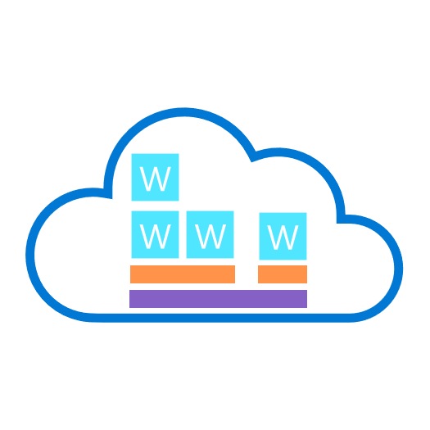





How to get started? Cloud operating model
W
W
W
W
Global Operations
Portfolio Operations
W
W
W
Central Operations
W
W
Workload
Workload Operations
Landing Zones
Platform Foundation
Notes:
<Key point>: The process of selecting a cloud operating model is different for every customer.
In decentralized models, every workload is managed on its own. Workload Operations don’t require landing zones. The Microsoft Azure Well-Architected Framework provides best practices and technical guidance to ensure workloads are high-performing, secure, and compliant workloads.
As the customer evolves their operating model, they may have Central Operations. They may have multiple workload with shared services. Workloads are running on the landing zone based on security, compliance, and governance policies of the organization. In these scenarios, we have seen implementations from CAF Migration blueprint, CAF Foundation blueprint, and even Terraform.
As customers continue in this evolution or move on to Portfolio Operations for their operating model in the cloud, things become more complex. We may have multiple landing zones operating on the platform foundation. In these scenarios, Enterprise-Scale Landing Zones have proven to be excellent solutions, providing a robust foundation to help customers manage a very complex, and growing portfolio in the cloud.
As customers move, and continue to grow in complexity, resources, and in different geographic locations (and regions), it is important that mature growth be mapped to the landing zones, supporting them as they grow.
<Transition>: Let’s look at some customer stories to learn more.

Slide 15
CAF Foundation blueprint Customer Story #1
Deployed 3 low-risk production workloads
Govern disciplines implemented
CCoE team established
Situation
Complex technical decisions
100% parity between on-prem & cloud
Week 1 | Week 4 | Week 8 | Week 12 | Week 16 | Week 20
Initial landing zone deployed
Manage disciplines implemented
Full-scale cloud deployment plan resumed
Creating landing zones unlocks cloud adoption through migration scenarios
Understand customer approach – platform development velocity
As the team gains skills & confidence, they expanded scope & took on more complex workloads
Key learnings
Notes:
<Key point>: The first customer story comes from the CAF Foundation blueprint.
The customer found themselves in difficulty. They were concerned with their on-prem operating model and wanted to move it entirely to the cloud. It didn’t work, and the customer had some additional complexities in their on-prem environment that were not easy to migrate. The customer was blocked.
The Microsoft field team approached them, and said, “Let’s go slow.”
[Microsoft speaking to customer]: “Let’s help you understand that we can’t move everything at once. This is not parity 100% from on-prem to cloud, and let’s take that journey together.”
The customer agreed, and supported the Microsoft team, who began working with the CAF Foundation blueprint.
The landing zone was deployed in one week! Three weeks later, we already had a few low-risk workloads deployed in production in the landing zone.
In a month, the value of the cloud was proven to the customer. From that point, the customer was unblocked, and felt the growing confidence within their team.
The customer experienced comprehensive support from the Microsoft team—having the environment configured properly, growing with the customer as their skills grew, helping the customer move forward with governance and principles of cloud management—all the way to creating a Central Cloud Center of Excellence (CCoE), helping them move forward and grow in their journey.
[Review Key learnings]
key messaging:
“It was important for Microsoft to understand the kind of support the customer needs—enabling the customer to feel confident, grow, and develop as their implementation and portfolio on Azure grew.”
<Transition>: Let’s look at the second customer story.

Slide 16
Enterprise-Scale Landing Zones
Customer story #2
Vision agreed on and implementation to start
Critical migration milestones completed
Additional migration and new projects
Situation
Existing ‘landing zone’, not ready for migration projects
Week 1 | Week 4 | Week 8 | Week 12 | Week 16 | Week 20
Enterprise-Scale landing zones deployed
Full-scale migration plan resumed
Creating landing zones at scale to unlock cloud adoption through migration scenarios
Understand customer approach – platform development velocity
Workshop sessions with customer to address landing zones design decisions – design areas
Key learnings
Notes:
<Key point>: The second customer story comes from the Enterprise-Scale Landing Zone.
This is a customer that is more mature. They already had several solutions, implementations, and landing zones running on Azure.
At this point, they had more important, complex, and critical projects than their previously environments on Azure. They now wanted to migrate these projects to Azure.
Therefore, the landing zones that they had already did not support these projects. The customer was blocked.
The Microsoft team, went in again, and shared the vision—the functionalities of the Enterprise Scale Landing Zones, communicating with the customer about:
The flexibility ESLZs have in their design configurations, the freedom to properly customize this robust environment to customers needs,
The thorough analysis required to define the architecture for a very robust landing zone.
Microsoft worked with the team, and worked with the customer, moving forward with a scenario where the customer was able to deploy the Enterprise-Scale Landing Zone.
The critical projects that needed to be migrated were completed in just a couple months after that.
[Review Key learnings]
key messaging:
“Not only was the customer blocked for these important projects, but they gained additional levels of confidence to move into new projects.”
“Microsoft is working with this customer in particular—working with them now on SAP and WBD projects that were not close to being considered.”
“This scenario is critical. Of course we are helping customers move forward with landing zones and deploying at scale. What was a good learning process for the team was the collaboration with the customer! It was not a simple one, two, three recipe. It was important to talk, and work with the customer in these working sessions—working with them, workshop-style, defining those landing zones, together.”
There are a lot of great opportunities with technology and technical guidance from Microsoft Azure—helping customers to move forward in their cloud journey.

Slide 17
Partner Opportunities
Notes:
Choose slides between 17 through 20 depending on your customers need and whether you need information for partners.

Slide 18

Start small and expand
→ CAF Migration, Foundation & Terraform
Build something quick and easy
Understand business priorities and motivations
Validate desired cloud operating model
Define governance, security, and compliance
Support customer’s skilling needs
Design Azure landing zones, based on design areas
Deploy workloads to Azure
Notes:
Start small and expand allows customers to build something quickly and learn/iterate with the process

Slide 19

Rich initial implementation
→ Enterprise-Scale Landing Zones
Build something robust and durable
Understand current cloud platform state and motivations
Validate cloud operating model
Review governance, security, and compliance
Design Azure landing zones, based on design areas
Deploy workloads to Azure
Notes:
For guidance on more complex landing zones go with “Rich initial implementation”
Enterprise-scale landing zones help customers that are already more robust, on the cloud and need a more durable and comprehensive solution. Microsoft has comprehensive technical guidance such as GitHub repositories, the ARM templates, to help get started and help the customers all the way through to the deployment of the workloads on Azure

Slide 20
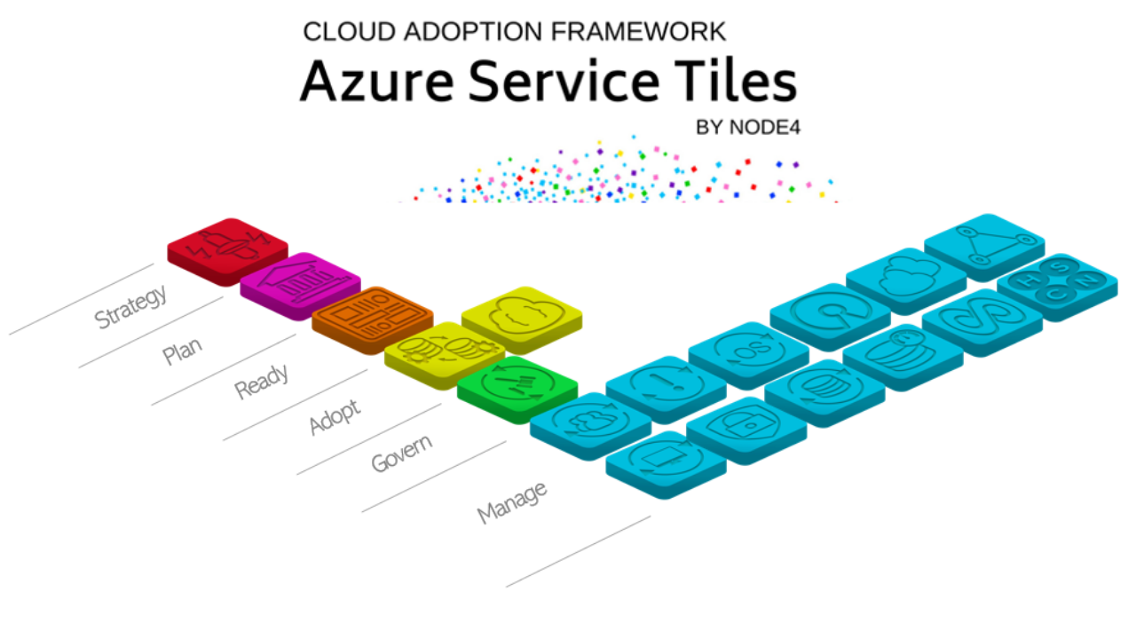

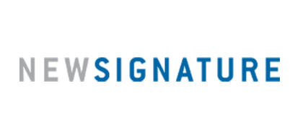
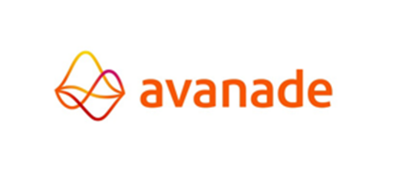
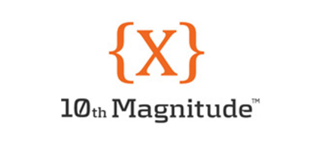




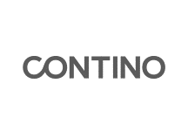

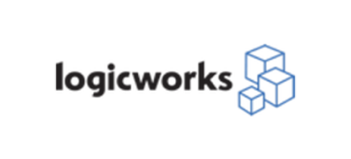

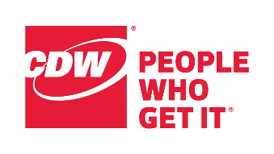
Azure Service Tiles & 1-week Landing Zones
Azure Landing Zones thru Partners
CAF aligned partners
aka.ms/adopt/partneroffers
Notes:
<Key point>: What cloud adoption products and services are offered through Microsoft partners?
[Microsoft speaking to partners]:
key messaging:
“We know partners have been in this journey to cloud adoption (with the Microsoft Cloud Adoption Framework) from the beginning.”
“You have embraced this Framework, and you have built practices, and services, and offerings on top of it with a lot of passion, because it helps your business as well.”
“You build that trust in customers because your knowledge and your expertise is critical for these customers.”
[At “CAF-aligned partners” animation]:
key messaging:
“I know that this is represents only a small number of the partners Microsoft has, but there are many of you working to support in this effort that we have around the Microsoft Cloud Adoption Framework, helping the customers.”
“I think about this, going back to my analogy of constructing a house. You build it yourself—you build your own house, or you find a contractor. When you find a contractor, you’re looking beyond the knowledge and the technology. You’re looking for that expertise, and that’s what all of you bring! It’s very valuable, with partners like Node4, who has already created an offering on the landing zones, helping customers become unblocked, and move forward in their cloud adoption journey.”
<Transition>: What resources are available for our Microsoft partners?

Slide 21
Resources
Notes:
[Title slide]

Slide 22
Deploy cloud-ready environments
Read the Documentation
Microsoft Cloud Adoption Framework for Azure
https://aka.ms/adopt/overview
All the resources available at
Azure.com/partners
Learn about Azure Landing Zones
Azure Landing Zones
https://aka.ms/adopt/landingzones
Implement Enterprise-scale Landing Zones in Azure
Examples and GitHub resources for implementation
https://aka.ms/adopt/landingzones/enterprise-scale/implementation
Your IP & Services
Cloud Adoption Framework for Azure
Customer Success
Notes:
<Key point>: Microsoft offers comprehensive resources with curated, technical guidance and best practices for successful cloud adoption.
[Microsoft speaking to partners]:
key messaging:
“I want to pinpoint three links, with resources specific to this session”:
“The Cloud Adoption Framework documentation—this is where you’ll find the roadmap for the entire cloud adoption journey.”
“The two main areas we covered today—the Azure landing zones documentation, and the Enterprise-scale Landing Zones—and GitHub repository/for resources for reference implementations for the architecture.”
“Our customers’ success depends on the technology, the documentation, the knowledge that we have and share. But most importantly, customer success rests on the IP and the services that you provide. Let’s continue to build customer success, together.”
<Transition>: Thank you for being Microsoft partners!

Slide 23
Thank you!

